Slide 1
Chapter 1
Getting Started with Alice

Slide 2
Outline
Introduction to Alice
  Why learn about programming computers?
  How you will learn to program with this book and Alice
  The basics of computer programming
  Why is it called Alice?

Slide 3
Outline (cont.)
Alice concepts
  Concept: Virtual world
  Concept: Objects and 3D models
  Concept: Three dimensions and six directions
  Concept: Center of an object
  Concept: Distance
  Concept: Position
  Concept: Animation
  Getting Started with Alice

Slide 4
Outline (cont.)
Tips & Techniques 1: Special Effects: Text and 2D Graphic Images
  3D text
  Graphic images (Billboards)

Slide 5
Why learn about programming computers?
Learning to program a computer does not turn you into a computer nerd
This book uses a system called Alice
  You will be a director of a play, where on-screen objects act out the script you create
What are the technological advances thanks to computer programmers?

Slide 6
How you will learn to program with this book and Alice
In a different and more enjoyable way
As painless as humanly possible
Different approach, possible due to:
  Increased power of desktop computers
  Development of novel software that uses 3D
Alice use natural English language words, like ‘move forward’ or ‘turn right’
You’ll understand all the fundamental ideas involved in programming

Slide 7
The basics of computer programming
Program: is a set of instructions that tells the computer what to do and is a way to tell another human being what you want the computer to do
Documentation: comments in the program, a Web reference, or an accompanying written document
The key to computer programming is to get a handle on the fundamental ideas

Slide 8
The basics of computer programming (cont.)
Fundamental ideas
  A list of instructions (sequential processing)
  Ifs (conditional executions)
  Repeating behavior (looping or iteration)
  Breaking things up into smaller pieces (problem decomposition, or stepwise refinement, or top-down design – reductionism)
  Compute a result (calling a function)

Slide 9
The basics of computer programming (cont.)
What can make things hard is complexity
Learning how to think about arranging a sequence of instructions to carry out a task (how to design a program) is probably the most valuable part of learning to program
The best way to communicate your design is to sketch the design on paper or whiteboard (flowcharting)

Slide 10
The basics of computer programming (cont.)
Flowchart symbols
terminal
Input/output
process
call
decision

Slide 11
The basics of computer programming (cont.)
Flowchart connectors
on-page
off-page

Slide 12
Why is it called Alice?
In honor of Charles Lutwidge Dodson, an English mathematician and logician who wrote under the pen name Lewis Carroll
He new that the most important thing was to make things simple and fascinating to a learner

Slide 13
Alice Concepts
Object-Oriented programming: Alice is based on the use of objects
You will create worlds on your computer and populate them with some objects in creative scenes
You will write programs (movie scripts or video game controllers) to direct your own production of animations in those worlds

Slide 14
Class
Objects are categorized into classes
Each object is
an instance of the class.
All objects in a class have similar properties and generally can perform the same tasks.
peter
Person
paul
mary
spike
Dogs
scottie
fluffy

Slide 15
Virtual World
Video games and simulations can be either 2D or 3D
A video game or simulation implemented in 3D is called a Virtual World, having width, height, and depth
Camera shots captured from different angles shows object that give a sense of being real

Slide 16
Objects and 3D models
An object is any thing that can be identified as unique from other things
How is an object unique?
  has a name
  has properties:
    width, height, color, location
  can perform actions (methods):
    associated actions it can perform
    tasks it can carry out

Slide 17
Objects and 3D models (cont.)
3D Model is like a blueprint used to design a house
An Alice 3D model tells Alice
  How to create a new object in the scene
  Provides instructions on
    How to draw the object
    What color it should be
    What parts it should have
    Its size (height, width, and depth)
    Many other details
Alice is not a 3D graphics drawing program

Slide 18
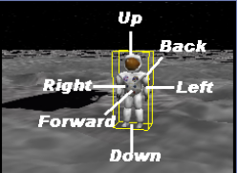
3 Dimensions, 6 Directions
A 3D object has
  3 dimensions
    height, width, depth
  6 degrees of freedom (directions of movement)

Slide 19
3 Dimensions, 6 Directions (cont.)
A 3D object “knows”
  which way is up or down, left and right, and forward and backward relative to itself
  The directions are with respect to the object, not the camera’s point of view
  An object’s orientation is the direction and angle at which an object is facing forward
  A bounding box (yellow box) highlights the selected object

Slide 20
Center of an object
Each object has a unique center
The center is set when the 3D model is first created
Usually, it is at the center of its bounding box or as near to the center of mass as the graphic artist could determine
The center point provides a reference for a pivot or spin type of movement

Slide 21
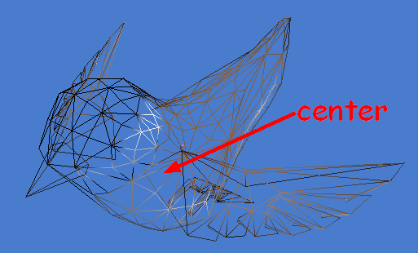
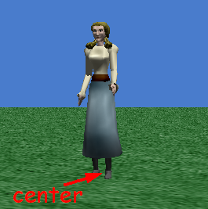
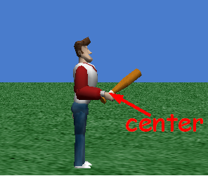
Center of an object
  At the center of mass
  Where it stands on the ground (objects that sit or stand on the ground, or a table. For people objects, it is between their feet)
  Where it is held when used

Slide 22
Distance
One object’s distance to another is measured from its center

Slide 23
Position
The center of an object is the point used as its position in a world
Alice automatically puts the center of the ground at the center of the world
Any object in the world is located relative to the center of the world

Slide 24
Animation
Animation is a fantasy of vision, an illusion
To generate this illusion, the filmmaker and artist collaborate to create a sequence of artwork frames (drawings or images) where each has a slightly different view of a scene
The scene is drawn with objects, and then redrawn with objects positioned in a slightly different place

Slide 25
Getting started with Alice
We encourage you to experiment with the Alice system in much the same way as you would explore a new cell phone
You take it out of the box and try out all its cool features – sort of a ‘poke and prod’ kind of procedure

Slide 26
3D text
Click on the Create 3D Text thumbnail in the Local Gallery
A text dialog box pops up for entering text
The dialog box allows
  Font, Bold, Italic
To modify the text in the object string, click on the text in the properties list of the detail panel

Slide 27
Graphic images (Billboards)
Billboard: is a flat 2D image that can be created in any paint tool and saved in GIF, JPG, or TIF formats
Click on File/Make Billboard
  Navigate to the stored image
  Click the Import button
Common uses:
  Provide information to the user about how to play a game or simulation

